Slide 1
The Customer

Slide 2
Customer Role
The customer describes the project vision, the project main stories, and the guidelines according to which development priorities will be set.
The architects present their vision about the product architecture, including the existing architecture and anticipated changes.

Slide 3
Customer Role
The project manager presents his or her view of the development process and the working environment as well as his or her personal expectations.
Other stake holders present their expectations from the development process.

Slide 4
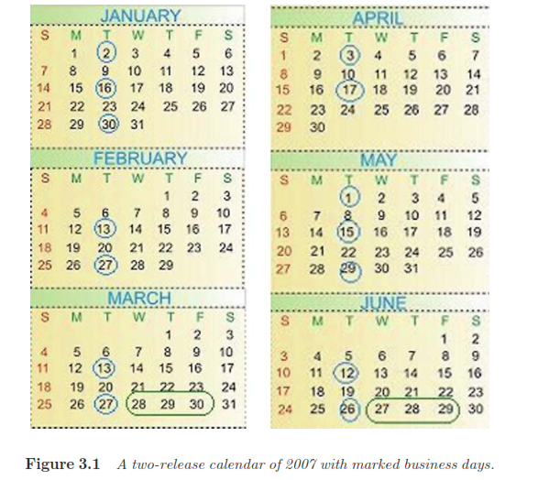
Business days

Slide 5
Business Day
The main Business Day activities are:
presentation of the accomplishments of the ending iteration;
measures’ review;
customer feedback;
reflective session;
planning of the next iteration.

Slide 6
presentation of the system
The features that are presented belong to specific customer stories of the ending iteration.
We demonstrate progress by delivering tested, integrated code that implements a story. A story should be understandable to customers and developers, testable, valuable to the customer,

Slide 7
Measures review
The product metric (the number of written and passed tests),
The pulse metric (a measure of continuous integration Measures)
The burn-down metric (an estimation of the convergence to the release/iteration goals),
and fault metrics (the number of new and open defects).

Slide 8
Customer feedback
The customer feedback is a short, informal verbal summary of the iteration, given by the customer. This direct feedback usually focuses on the product rather than on the process. It is important to include the customer’s message in the iteration summary to signal the customer’s importance in the development process. It also helps in focusing people on the product as an end goal,

Slide 9
The reflective session
The reflective session is intended to discuss a specific issue in the development process, and to change the process if needed.

Slide 10
Planning the next iteration
Time is an important resource and should be managed wisely.
The smaller a development task is, the more accurate its development time estimation is. Thus, product delivery on time and of high quality is better ensured.
An ordered professional work environment is required by professional practitioners; chaos frustrates professionals especially because the resulting products are of low quality and their professionalism is doubted.
Fairness and a cooperative work environment are valued by professional developers; an open and transparent work distribution, in which all parties are involved, increases practitioners’ security, trust, and cooperation.

Slide 11
Customer Collaboration
To focuses on the common language required in order to maintain ongoing communication with the customers.
First, be aware of metaphors.
Second, encourage developers to provide multiple metaphors:
( NOTE: A metaphor is a figure of speech that describes an object or action in a way that isn’t literally true, but helps explain an idea or make a comparison.)

Slide 12
The User
The human computer interaction (HCI) field emerged in the early 1960s.
Norman (2006) suggests abandoning the traditional HCI approach of ‘‘study first, design second’’ and to try the ‘‘design, then study’’ approach.
The integration of the user in the development environment is accomplished by the User Centered Design (UCD) approach, which is a set of design techniques
that emphasizes user needs during the design of the user interface. This is achieved by managing user evaluation with validated user evaluation techniques (Vredenburg et al. 2002).

Slide 13
UCD
There are two main types of evaluation:
1. expert-based evaluation and
2. user-based evaluation.
Expert-based evaluation, a designer or an HCI expert assesses a design of user interfaces based on known cognitive principles or empirical results.
The user based evaluation is based on user participation, i.e., evaluation that involves the people who are going to use the system. User-based evaluation techniques include experimental methods, observational methods, questionnaires, interviews, and

Slide 14
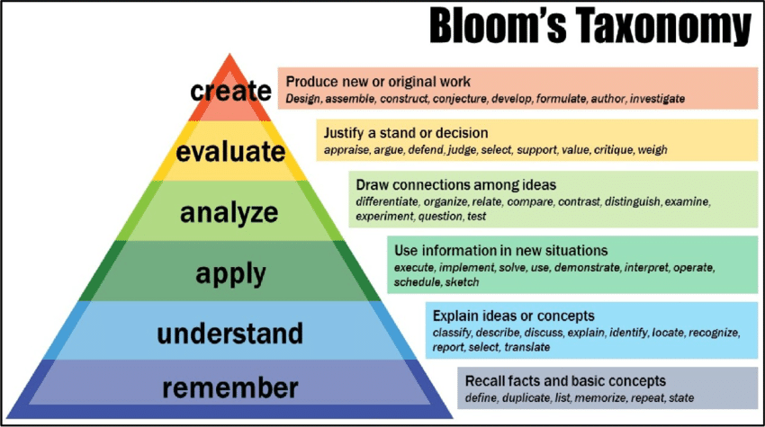
Cognitive principles

Slide 15
Combining UCD with Agile Development
3.5.1.1 Case Study 3.1. Merging Development Iterations with User Evaluation Iterations
This case study illustrates the combination of UCD with agile software development in a specific software project called Catalogue Browsing Project (CBP) in

Slide 16
CBP
The first release of CBP was developed by two people during four months and divided into
four iterations of about three to five weeks. Customer collaboration and user evaluation were emphasized during the development process.

Slide 17
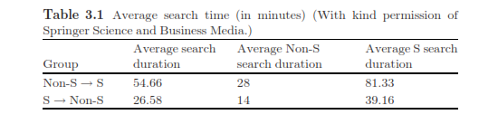
An automatic time measure

Slide 18
Customers and Users in Learning Environments
Elicit Communication
Use Metaphors or ‘‘Other World’’ Concepts
Case Studies of Metaphor Use
Case Study 3.2. Identification of Short Sequence Repetitions in a DNA Sequence
Case Study 3.3. Personal Information Organizer

Slide 19
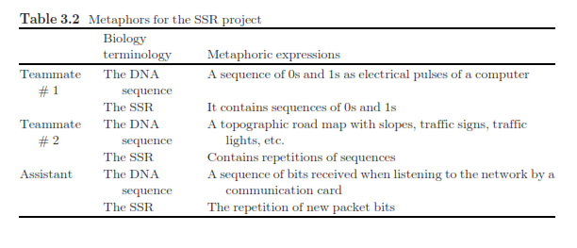

Slide 20
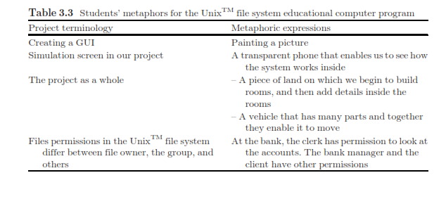
Case Study 3.4. Simulator of the Unix TM File System Module

